Slide 1
Review of the pay data for the city of ny: Are women and men employed & paid at the same rate?
By: Pratima Doodnauth

Slide 2
Introduction
I currently work with EEO data and I look at how representative the City’s workforce is when compared to the availability in the labor market.
I am reviewing the pay data that was released by the City of New York in response to the passage of Local Law 18 of 2019.
I was interested in this topic since the city employs over 200,000 persons and I wanted to review the pay across agencies, Job Groups, Gender and Ethnicity.
I suspect as is the case in most places that women and men do not earn the same and that minorities earn less than whites and that specific job groups attach specific genders which contribute to the pay gap.

Slide 3
Data sources
My data was obtained from ‘NYC OPEN DATA’:
https://data.cityofnewyork.us/City-Government/Local-Law-18-Pay-and-Demographics-Report-Agency-Re/423i-ukqr
The data was based on calendar year 2018 data and covered 180,000 City employees across 36 City agencies and the report was released in October 2021
My original dataset had 17,771 rows and 9 columns
The data was grouped by EEO Job Groups

Slide 4
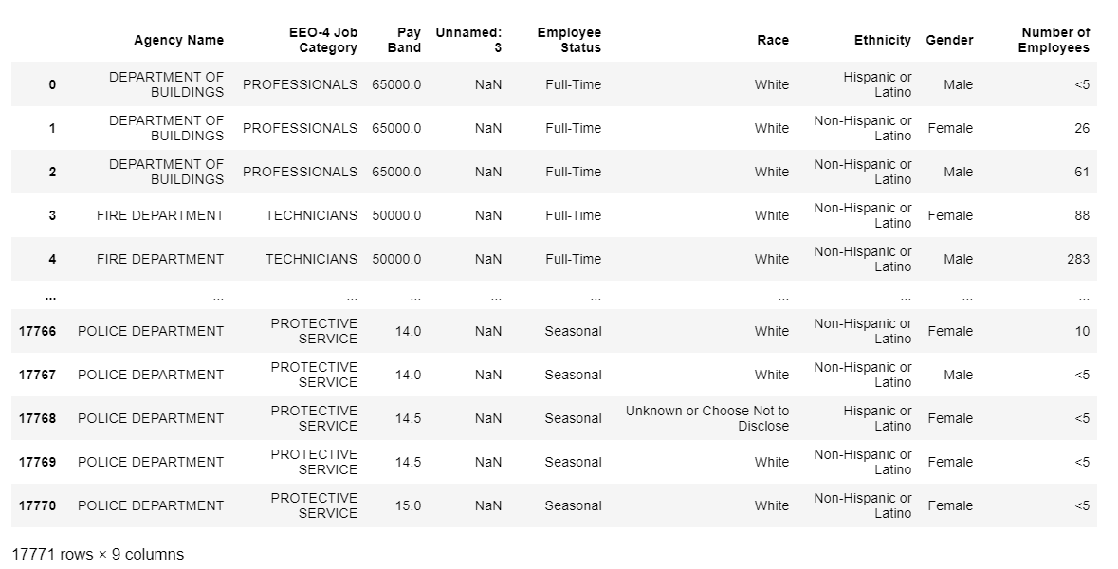
Original dataset

Slide 5
Data cleaning
Exploratory Data Analysis
No missing or blank data
### Dropping blank Column
## Filtering Data set to just focus on Full-time workers and Job Groups with >5 employees
## Renaming Columns
### Data Review

Slide 6
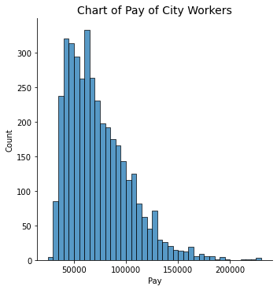
Pay range of city’s workforce

Slide 7
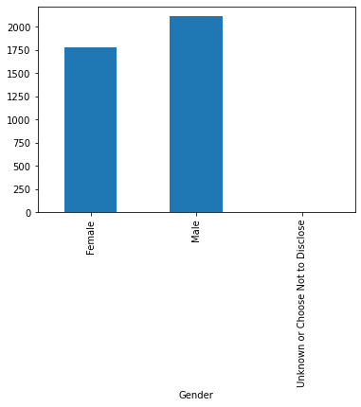
Gender make-up of the city’s workforce

Slide 8
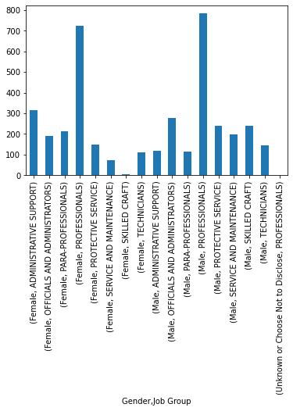
Distribution of Workforce by job group

Slide 9
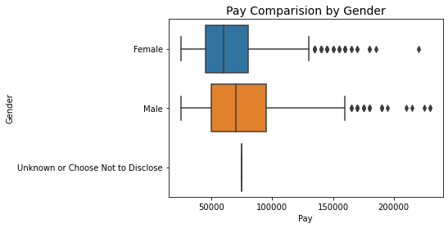
Pay by gender

Slide 10
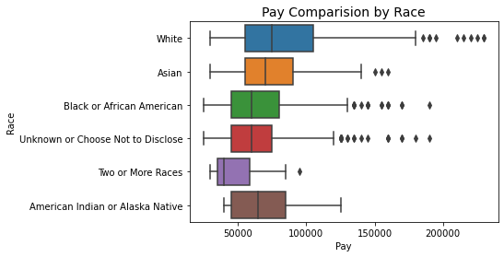
Pay by Race

Slide 11
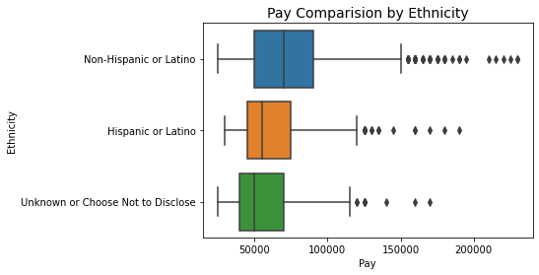
Pay by ethnicity

Slide 12
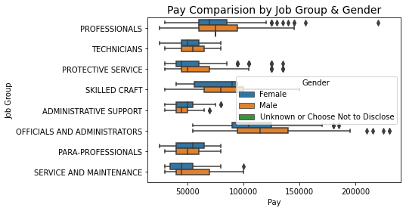
findings

Slide 13
